Slide 1
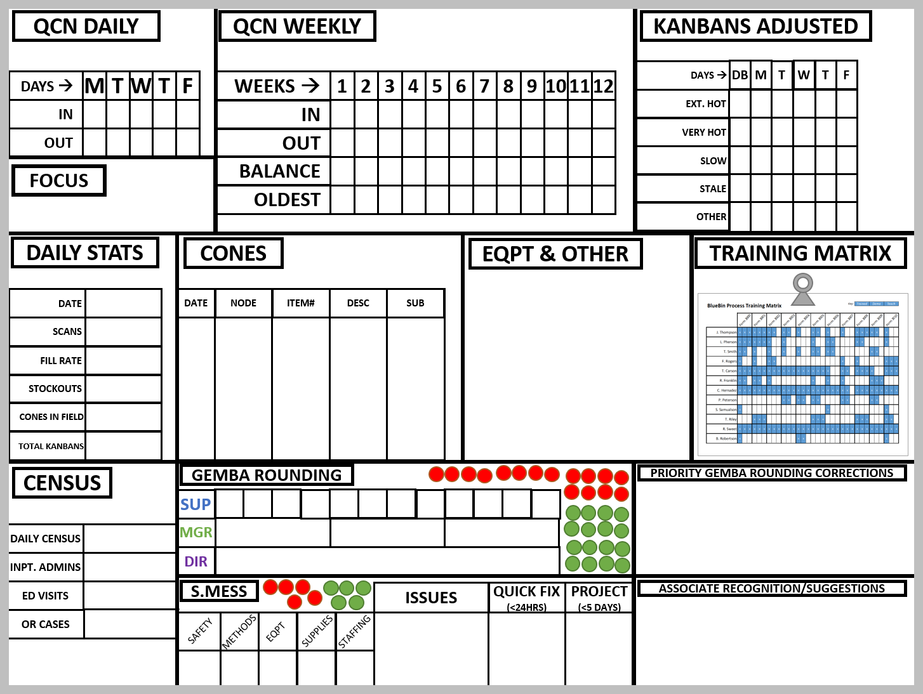
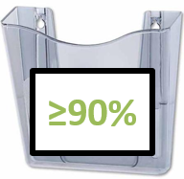
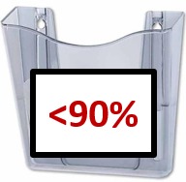
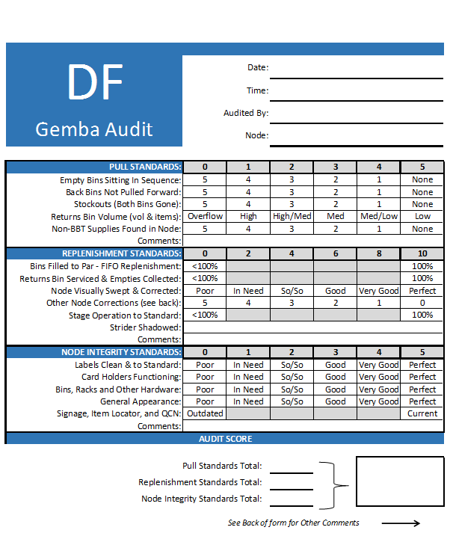
Supplies:
3’x4’ magnetic marker-board w/tray
1/4” black art tape (2RL)
1/8” black art tape (5RL)
Utility Knife
Scissors
Dry erase markers
Dry eraser
18” ruler or yardstick
Pre-laminated tags w/magnetic strips adhered
Docu-pockets (2)
Blue, Green, & Purple clipboards (1EA per color)
Red & Green Dots (20EA per color)
Magnetic Tape
3lb wire hooks (3)
Blank Gemba Audit Forms
*See supplies & equipment list for additional detail

Slide 3
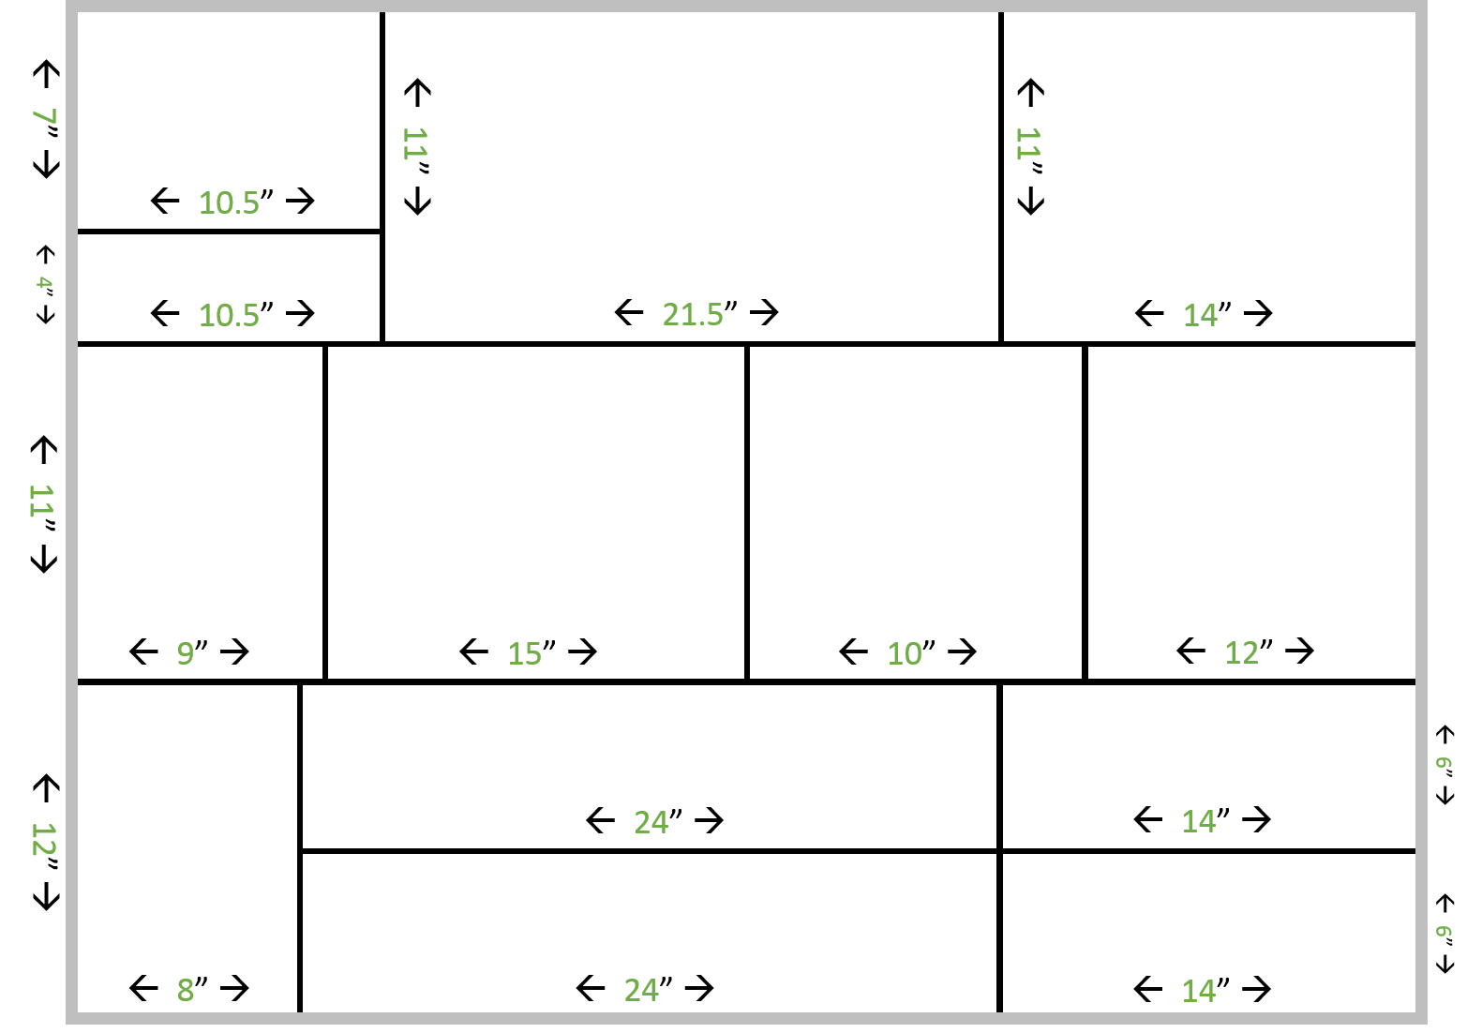
Using 1/4” black art tape, create the compartmentalized frames identified here. Use a ruler, dry erase markers, utility knife, and any other material necessary to create straight, proportioned lines.
Note the gray outline indicates the metal border of the dry erase board, do not use black tape for the outside border (leave as-is).
*DO NOT STRETCH TAPE, IT WILL SHRINK AND LOSE ITS SHAPE

Slide 4
QCN DAILY
QCN WEEKLY
KANBAN ADJUSTEMENTS
DAILY STATS
CONES
EQPT/OTHER
TRAINING MATRIX
CENSUS
S.MESS
PRIORITY GEMBA CORRECTIONS
GEMBA ROUNDING
ASSOCIATE RECOGNITION & SUGGESTIONS

Slide 5
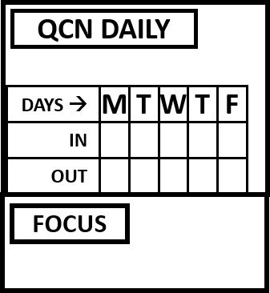
TAG ONLY NO TAPE
Use 1/8 ” black tape to create all internal tables for laminated tags and boxes for hand-writing
*DO NOT STRETCH TAPE
Make sure top of this table and QCN Weekly table are level
1.5”x3”
1.5”x1.5”
TAG ONLY NO TAPE

Slide 6
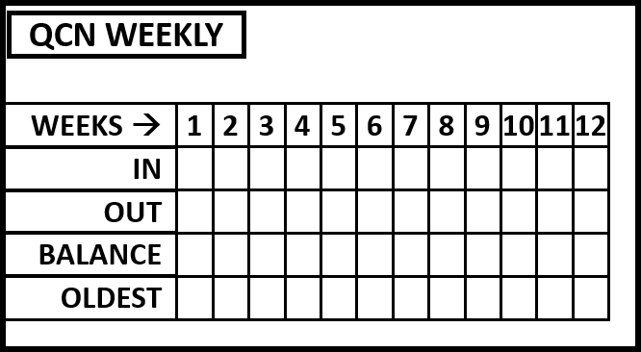
Make sure top of this table and QCN Daily table are level
TAG ONLY NO TAPE
1.5”x3.5”
1.5”x1.5”
Gap at bottom of box is ok, as long as top of table is level with QCN daily box

Slide 7
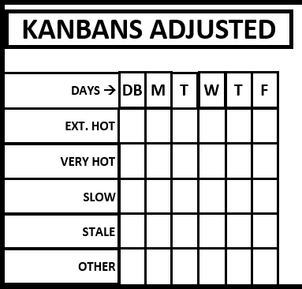
TAG ONLY NO TAPE
1.5”x4.5”
1.5”x1.5”
~1/2” gap from right ledge of table to ledge of board is ok

Slide 8
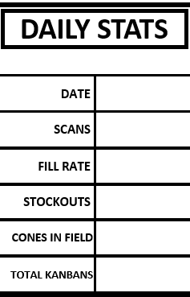
TAG ONLY NO TAPE
1.5”x4”
1.5”x5”

Slide 9
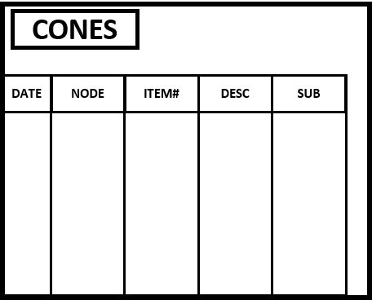
TAG ONLY NO TAPE
1.5”x2”
7.5”x2”
7.5”x3”
7.5”x3.5”

Slide 10

TAG ONLY NO TAPE
N/A for additional tape, just magnetic tag to caption box
This is a customizable compartment based on hospital preference. Can be used for equipment rounding, listing daily route striders, etc. New tags can be made to caption box if appropriate (follow dimensions of other tags for consistency)

Slide 11

TAG ONLY NO TAPE
N/A for additional tape, just magnetic tag to caption box, then post color copy of Training Matrix w/magnetic bulldog clamp

Slide 12
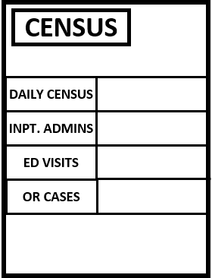
Customize tags as needed based on hospital’s reporting methods. The example here is a common format, but potentially more or less detailed based on hospital metrics.
1.5”x4”
1.5”x4”

Slide 13
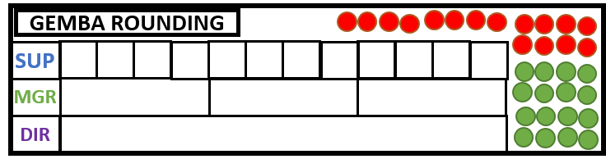
TAG ONLY NO TAPE
1.5”x2”
1.5”x1.5” (12)
1.5”x6” (3)
1.5”x18” (1)
Red Dots (15)
Green Dots (15)
*See pg 1 of tag signage document for instructions

Slide 14
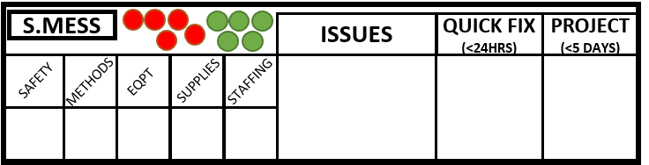
TAG ONLY NO TAPE
Red Dots (5)
Green Dots (5)
*See pg 1 of tag signage document for instructions
No gap, stretches from top to bottom
2”x2”
4”x6”
2”x6”
4”x4”
2”x4”

Slide 15
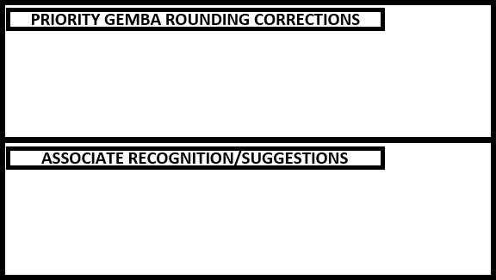
TAGS ONLY NO TAPE

Slide 16



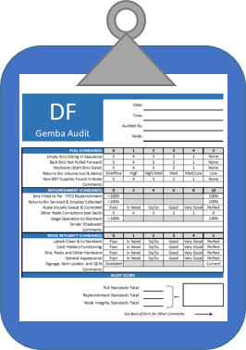
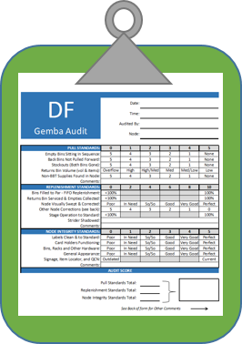
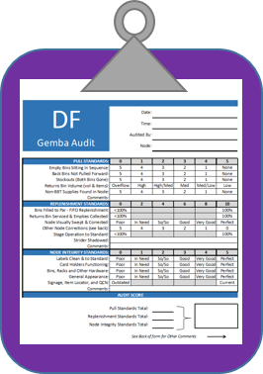
Adhere 3 - 3lb wire hooks underneath the huddle board, in a symmetrical pattern to hang the blue, green, and purple Gemba Audit clipboards.
Clipboards can be arranged to either side of the board as well depending on space. Ideally, they are placed as close to the Gemba Audit portion(s) as possible
Blue = SUP
Green = MGR
Purple = DIR

Slide 17


May need Facilities department help to mount docu-pockets on wall, to the right of the huddle board.
Docu-pockets can be arranged to the other side of or below the board as well depending on space. Make sure their positions to not inhibit ease of dropping and collecting Gemba Audit Forms.
Pre-laminated tags included in Huddle Board Signage Tags document. Attach with double-sided or carpet tape.

